Slide 1

Kobestu Kaizen Pillar
TPM
JISHU HOZEN (Operator himself maintaining the M/C)
KOBETSU KAIZEN (elimination of losses)
SAFETY Health & ENVIRONMENT
DEVELOPMENT MANAGEMENT
PLANNED MAINTENANCE (achieving zero breakdown)
HINSHITSU HOZEN (zero defects)
OFFICE TPM
EDUCATION & TRAINING

Slide 2

What is mean by Kaizen
KK
The word “KAIZEN” is basically Japanese word. “KAI” means Continuous & “ZEN” means Improvement.
So Kaizen is nothing but Continuous improvement.
There are mainly 3 types of Kaizen.
2 Quadrant Kaizen – Operator level kaizen
4 Quadrant Kaizen – Supervisor level kaizen
Concentrated Kaizen – Engineering Kaizen

Slide 3
Kaizen
KK
2 QUADRANT KAIZEN ( OPERATOR KAIZEN)
Kaizen Area :
Kaizen topic :
Before
After
Fixed point Photograph
in JPG Format
Fixed point Photograph
in JPG Format
Photograph in JPG Format

Slide 4
Kobestu Kaizen
KK
4 QUADRANT KAIZEN ( SUPERVISOR KAIZEN)
KAIZEN AREA :
KAIZEN TOPIC :
Before
After
Write problem here :
Kaizen / counter measure –
Fixed point Photograph
in JPG Format
Fixed point Photograph
in JPG Format
Result :
Result :
Why Why Analysis –
Root Cause –

Slide 5
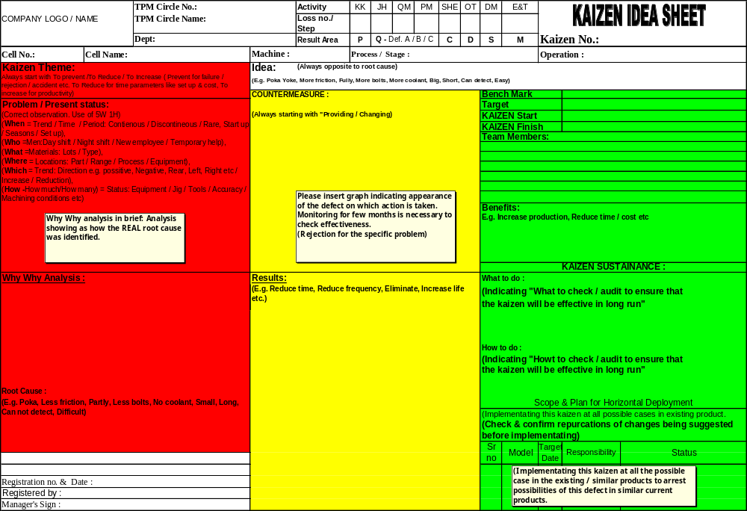
Concentrated Engineering Kaizen
KK

Slide 6
Aim of Focus Improvement Pillar in TPM
KK
To optimize the maximum utilization of equipment at reduced manufacturing cost & improve OEE by reducing / eliminating losses”.

Slide 7
Problems faced by companies
KK
External Factors
Internal Factors
Tough Competition
Globalization
Increase in
  Raw material cost
  Energy cost
Productivity low
Customer complaints
Defective products
Non - adherence to delivery time
Increase in wages and salaries
low knowledge and skill level of workers
Time Losses are high

Slide 8
Losses and why they occur
KK
Loss is defined as wastage of material, money, time and energy. Loss directly adding cost to company & simultaneously reduce profit of the organisation
Some of the reasons for the wastage can be summarized as below:
Whenever an operation exceeds it’s standard timings
Whenever an operation is interrupted
Whenever a non -value adding operation is performed
When a machine and or man do not give the rated out put.
Consuming additional time, money, energy than the specified norms etc.

Slide 9
Loss cost Relation
KK
Production
Productivity
=
Cost
Simultaneously

Slide 10
Loss cost Relation
KK
Reducing Variable Costs
Any decrease in the variable cost ratio to sales will of course reduce and improve the break-even point and increase the net profit where sales are above break-even point. Some of the more significant methods of reducing this variable cost:
a. Redesign of the product to reduce material and labor costs,
b. Substitution of less expensive materials, and the appraisal of purchasing costs, discount rates and freight rates.
c. Methods improvements in shop and office to reduce the direct and indirect labor required.
d. Use of wage incentives and/or profit-sharing to improve productivity
e. Reduce variable costs by reducing equipment & human losses to improve productivity.

Slide 11
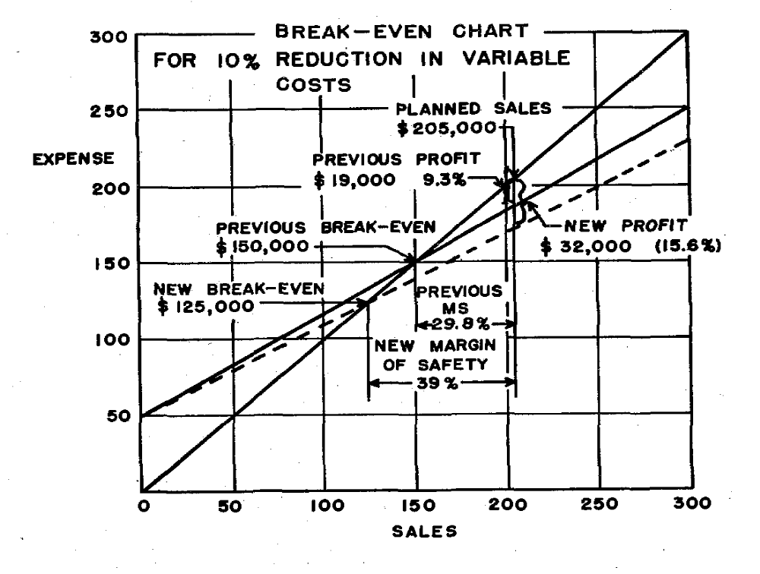
Profit Vs loss
KK

Slide 12
KK pillar Parameters
KK
No. | Area | Parameters | UOM | Bench Mark | Target
1 | Productivity | OEE | % | 85 | 90
 |  | Output per hour | Nos | 270 | 405
 |  | Output per man per shift | Nos. | 65 | 180
2 | Cost | Energy consumption/ ton | KWH
 |  | Tool cost per piece | Rs.per piece | 1.22 | 0.98
 |  | Consumable cost per piece | Rs.per piece | 1.37 | 1.096
3 | Delivery | WIP Inventory | No’s of Day | 2 | 1

Slide 13
Focus Improvement Methodology
KK
Define Losses
Capture Data on Losses
Prepare loss tree
Deploy loss elimination plan
Prioritize losses according to business need
Identify loss elimination projects
Identify loss elimination method
Deploy selected projects to team
Check & monitor business results

Slide 14
Focus Improvement Methodology
KK
Define Losses
Capture Data on Losses
Identify Losses reason and kaizen
Register Kaizen ideas
Work Kaizen ideas
Cross Functional Teams
TPM Circle
Pillar Sub Committees
Monitor Kaizen implementation
Pillar Sub Committee / Department TPM promotion committees
Horizontal deployment plan
Sustenance Through Pillar Activities.
Maintain Kaizen index

Slide 15
Overall Equipment effectiveness
KK
OEE of machine is a product of the availability rate, the performance rate and the product Quality rate.
Availability Rate > 90 %
Performance Rate > 95 %
Quality Rate > 99 %
OEE = A x P x Q = 90% x 95% x 99% = 85 %

Slide 16
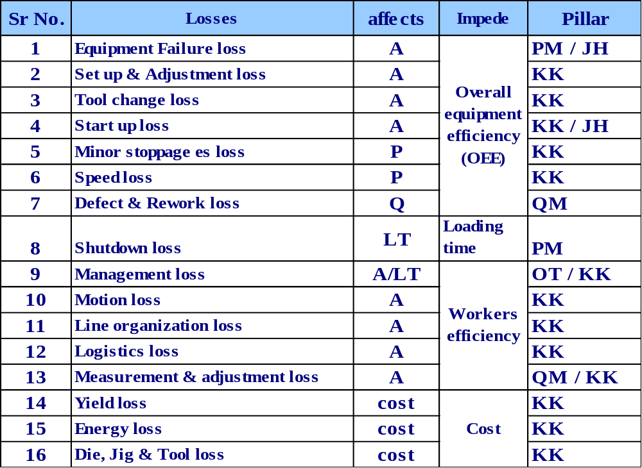
Losses affecting OEE
KK

Slide 17
Correlation chart of OEE and Loss “KAIZEN”
KK
Loss Tree
Better
DISPATCH
Better
Better
INVENTORY
Finish Goods Stock
PRODUCTION
Better
OEE
NO ORDER
SHUT DOWN
HOLIDAY
Better
Better
Better
AVAILABILITY
Better
PERFORMANCE
QUALITY
Better
JH / PM
KK
KK
KK
QM
Break down
Better
Startup
Loss
Better
Line Org. Loss
Better
Minor
Stoppage
Scarp
KK
KK
Better
Better
KK /OTPM
Setup &
Adj. Loss
Better
Management
Loss
Better
Logistics Loss
Better
QM
KK
Speed Loss
Rework
KK
KK
KK
Tool Change
Better
Motion Loss
Better
Measure &
Adj. Loss
Better
Better
Better

Slide 18
Overall Equipment effectiveness
KK
Total OEE ( OPE )
Theoretical production time
Available time for production ( Loading time)
Planned shutdown losses
Gross operating time
(A) Downtime losses
Setup & Adjust
Equip.
Failure
Net operating time
(p)speed losses
Reduced Speed
Idling loss
Valuable operating time
(Q) Quality loss
Reduced yield from startup
Defect loss
OEE

Slide 19
OEE Calculation
KK
Calculation of Overall equipment Efficiency (OEE) :
Loading time – Down time
1) Availability (A) =
Loading time
Loading time = Available time – scheduled down time
Scheduled down time includes, preventive maintenance, no power, no order, no schedule, JH/TPM meeting etc ‘ down time includes losses affecting availability.
Standard Cycle time X Units produced
2) Performance (P) =
Loading time – Down time
Units Produced – Defective units
3) Quality (Q) =
Units produced
A defective unit includes reworked and scraped quantity.
4) Overall Equipment Efficiency (OEE) = A X P X Q

Slide 20
OEE Calculation (Example)
KK
Overall equipment Efficiency (OEE) consists of three parts,
Loading time – Down time
1) Availability (A) =
x 100
Loading time
460 min. – 60 min.
=
x 100 = 87%
460 min.
Standard Cycle time X Units produced
2) Performance rate (P) =
Utilization hours (Loading time – Down time)
0.5 min/unit X 400 units
x 100
=
x 100 = 50%
400 min.
3) Quality rate (Q) =
Units Produced – Defective units
x 100
Units produced
=
400 units – 8 units
x 100 = 98%
400 units
OEE = A X P X Q = 0.87 X 0.50 X 0.98 X 100 = 42.6%
Approx 57% we are not utilized machine time

Slide 21
Overall Equipment effectiveness
KK
Theoretical production time = 480mins
Loading time=460
External losses =20mins
Gross operating time
Downtime =60mins
Setup & Adjust
Equip.
Failure
Net operating time
P loss = 200mins
Reduced Speed
Idling loss
Valuable operating time
(Q) Quality loss
Reduced yield from startup
Defect loss

Slide 22
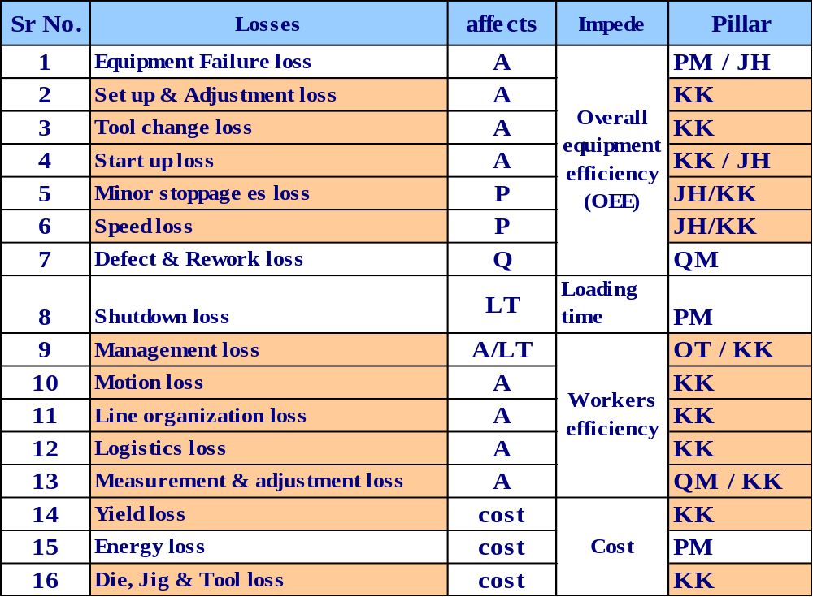
Losses taken care by KK pillar
KK

Slide 23
Definition Of Losses
KK
Loss No. | Loss Description | JIPM Definition | As Applicable
1-A | Equipment Failure Loss | Equipment function – stoppage or function deterioration. | Time loss due to break down of equipment / machine.
1-B | Fixture / Jig / Die Loss | Fixture / Jig / Die Function – stoppage of function deterioration. | Time loss due to break down of Die, Jig & Fixture.
2 | Setup & Adjustment Loss | Time lost in changeover from present item to good quality manufacturing of next item. | Time required for completely changing the Dies, Jigs & other tooling from last component produced of previous product / model to OK component of next product / model with adjustment for getting 1st piece right.

Slide 24
Definition Of Losses
KK
Loss no. | Loss Description | JIPM Definition | As Applicable
3 | Tool Change Loss | Time Loss resulting from change of cutting tools. | Time required to change the cutting tool, which is either due to pre-determined change frequency or broken premature or variation , which may cause dimensional discrepancy to the part produced.
4 | Startup Loss | Time Loss until product quality stabiles to manufacture non defective items. | Time loss due to delay in starting the equipment due to startup conditions like temperature build up etc. This loss is accounted from start till OK production commence.
5 | Minor Stoppages | Machine stoppages of idling due to temporary troubles. | Stoppages of equipment due to minor snags. Where the time for restoration is very small and also restoring the condition is easy. Interruption in process, Machine malfunctioning, disturbances ,Waiting time generated in multi process & Production line stopped but reason not known are the examples of Minor stoppages
6 | Speed Loss | Losses due to difference between actual speed and design speed. | The loss due to running the equipment at lower speeds than rated speed or operator taking more time for activity than planned.

Slide 25
Definition Of Losses
KK
Loss no. | Loss Description | JIPM Definition | As Applicable
7 | Defect and rework Loss | Losses resulting from defect and rework and time losses resulting rectification in to acceptable product. | Time loss due to no. of defectives produced at source during the shift cycle time (online).
8 | Shut Down Loss | The loss caused by stopping the equipment for periodical maintenance / inspection and for scheduled down time for legal inspection during the production stage. | Shut down loss is nothing but the planned stoppage .TPM / cell meeting ,Daily JH,PM,TBM Company approved meeting, Development trials, Planned maintenance, no order, no schedule etc.
9-A | Management Loss | Management loss is waiting losses, such as a waiting materials, tools, instructions and repair which is generated through management problems. | Stoppage of the equipment due to shortage of materials from feeder shop, due to want of material vendors,
 |  |  | Stoppage of equipment due to other resources like Waiting for required resources / inputs i.e. Man, Power, air, tools, raw, gas material, Instructions, container for collection of product etc
10 | Motion Loss | Losses resulting from action running counter to motion economics principle and arising from skill difference, bad layout. | Losses due to violation of motion economy 1. Search and select 2. Hold and wait 3. Unnecessary motion 4. Difficult posture.

Slide 26
Definition Of Losses
KK
Loss no. | Loss Description | JIPM Definition | As Applicable
11 | Line Organization Loss | Waiting time losses generated in multi process and multi machine processing and line balance losses in conveyor work. | Includes waiting time losses generated in the multi machines processing & also line balancing loss on conveyor work due to unequal distribution of work content.
12 | Logistics Loss | Logistics loss is the man hour spent in doing logistics work (Transportation of produced of raw material etc.) by other than logistics worker or the additional time spent by the logistics worker due to equipment failure. | Stoppages of the equipment for want of logistics reasons like internal material movement , delay in issue to line etc.
13 | Measure & Adjust Loss | Man hour losses resulting from frequent measurement and adjustment executed to prevent quality defect. | Equipment stopped by the operator for frequent inspection of parts and to make any adjustment if necessary to correct quality problems.

Slide 27
Definition Of Losses
KK
Loss no. | Loss Description | JIPM/CII Definition | As Applicable to Varroc
Three Major Losses that impede efficient use production resources
14 | Yield Loss | It is money loss due to insufficient use of direct materials i.e. Raw material. It affects cost. | It is money loss due to insufficient use of direct materials i.e. Raw material. Volume loss, weight diff. between raw material and finished product are examples of yield loss.
15 | Energy Loss | It is the money loss due to inefficient use of energy. It affects cost. | Losses due to energy such as Electrical power, Fuel, Compressed air, Water, Excess consumption of process consumables etc. are examples of Energy loss.
16 | Die/jig/Tool Loss | It is the money loss due to inefficient use of indirect materials. i.e. Tools, spares, ,jigs, dies etc. | Cost losses resulting from the manufacturing and repair of dies, jigs fixtures and tools necessary for production. Cost of above tools used for this purpose.

Slide 28
Loss No 1- Equipment Failure loss
KK
There are two types of failure loss
Loss No. A1: Equipment failure loss
Loss No. A2: Breakdown loss
This loss is expressed in time
Loss No. A1 is the time lost by the equipment due to a Breakdown involving the replacement of spare parts.
Loss No. A2 is the time lost by the equipment due to a Breakdown not involving any replacement of spare parts.
Since zero breakdown is our objective, target for this loss is zero.
This loss affects
Availability, OEE and OPE.

Slide 29
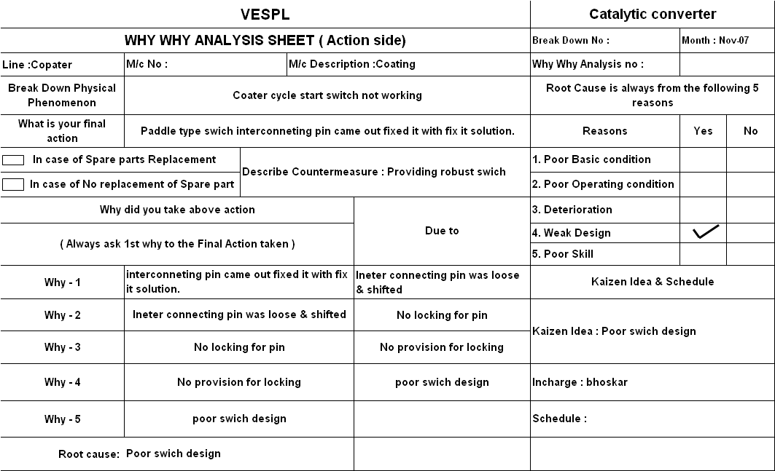

Slide 30
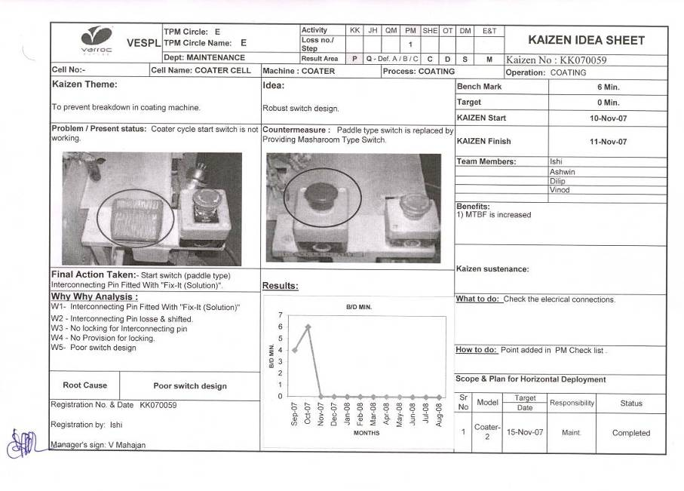

Slide 31
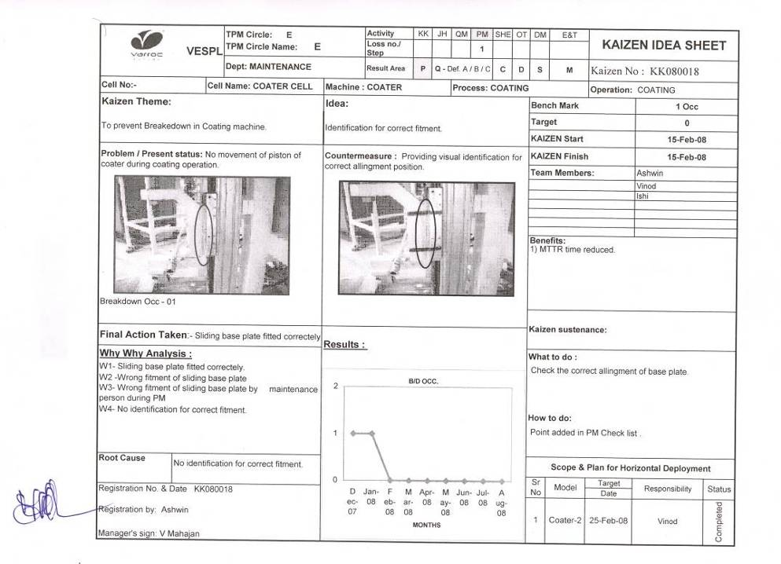

Slide 32
Loss No 2 – Setup & Adjustment loss
KK
This is more popularly known as job change loss or change over loss. This loss is expressed in time.
This loss represents the time lost by the equipment due to change over from one product to another.
This loss cannot be made zero. Our target is to reduce this loss to less than 10 minutes per station I.e. single digit target.
This loss affects availability, OEE and OPE.

Slide 33
Setup & Adjustment Principle
KK
During Set up analysis define each activity as internal / external activity.
Principle
Job set up change time present
40 min
Total job change time
Internal Activity (25 min) | External Activity (15 min)
Convert Internal activity into
external activity
12 min | ECRS
Elimination of adjustments by
ECRS principle : E – eliminate activity
C - combine activity
R – Reduce activity time
S – Simplify activity
 | parallel
Reduce Internal activity by
implementing parallel work
6 min
Reduce time (unavoidable adjustment)
by innovative kaizen
Job set up change can be reduced from 40 min to 6 min.

Slide 34
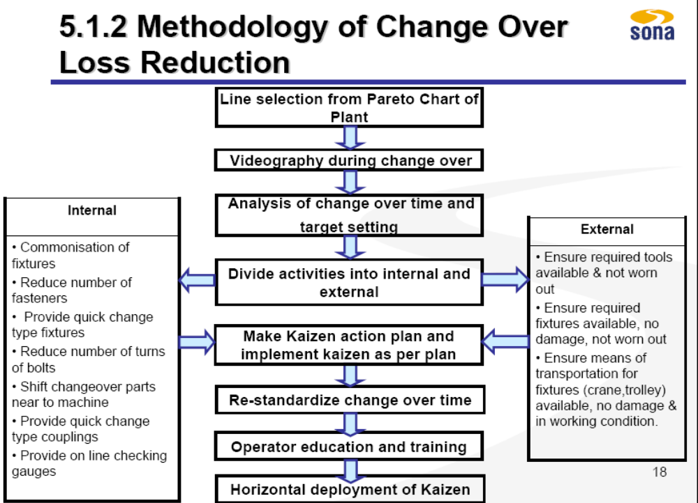
Methodology Setup and Adjustment Losses
KK

Slide 35
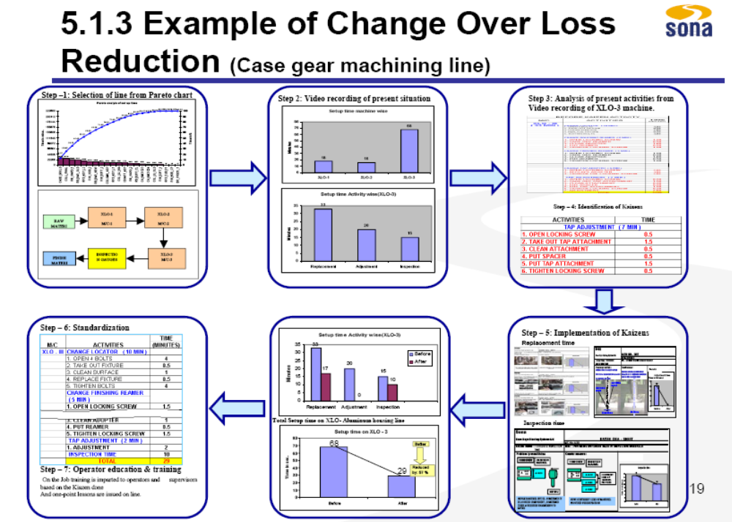
Setup & Adjustment Loss
KK

Slide 36
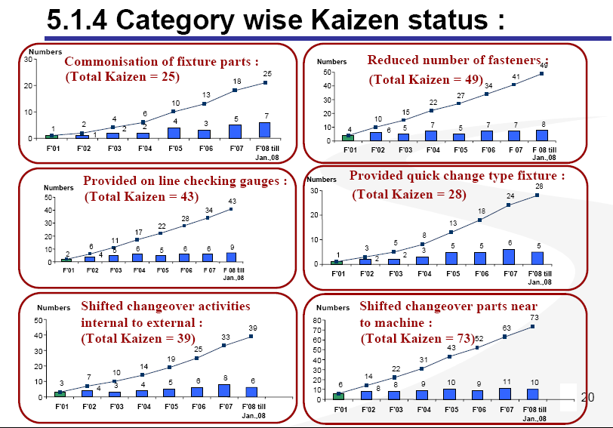
Setup & Adjustment Loss Result
KK

Slide 37
Loss No 3 – Tool change Loss
KK
Some companies categorise other losses closely related to tool change, under this loss the split of loss no. 3 as follows:
3A = Tool change loss
3B =Raw material/coil change loss
3C= Tool service loss
This loss is expressed in time.
This loss represents the time lost by the equipment due to change over a used tool/RM with a new tool/RM or re-servicing the old tool.
This loss cannot be made zero. Our target is to reduce this loss to less than 1 minute per tool or RM.
This loss affects Availability Rate, OEE and OPE.

Slide 38
Methodology –Tool change loss reduction
KK
Tool change loss reduction
Reduce Tool change
time
Reduce Tool change Frequency
Increase tool life
Eliminate
searching time
Change Internal to external

Slide 39
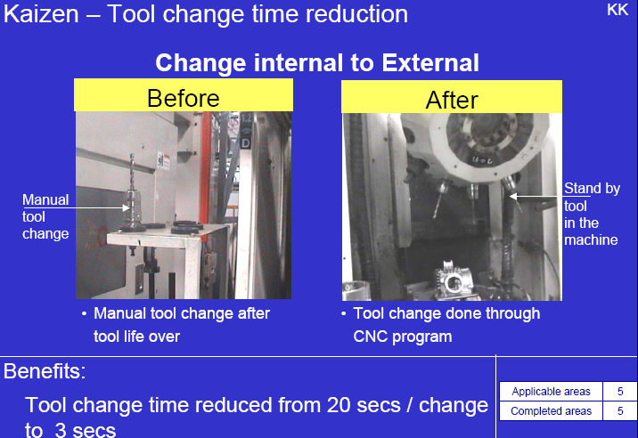
Tool change loss reduction
KK

Slide 40
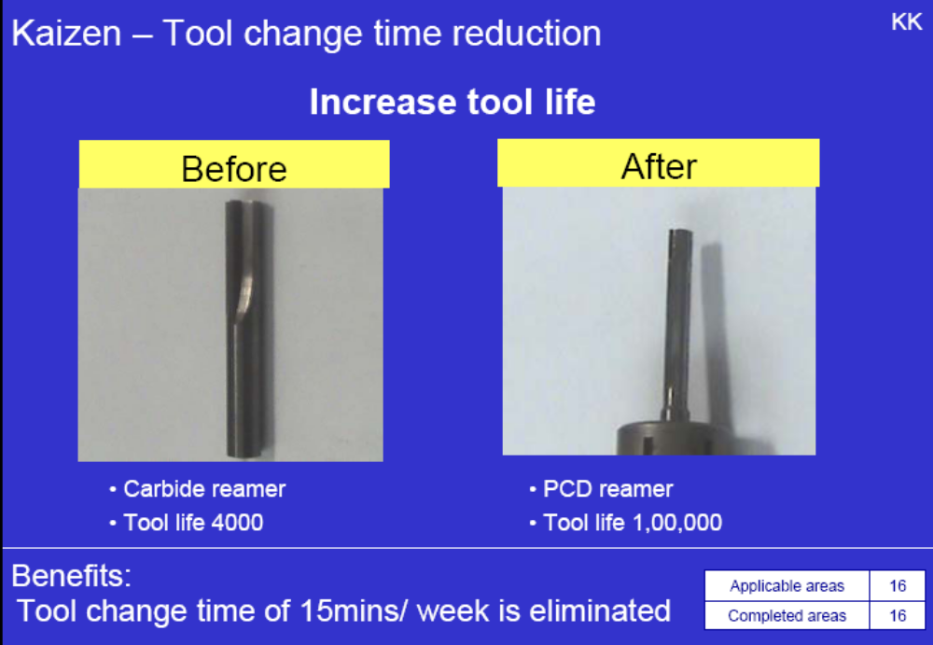
Methodology –Tool change loss reduction
KK

Slide 41
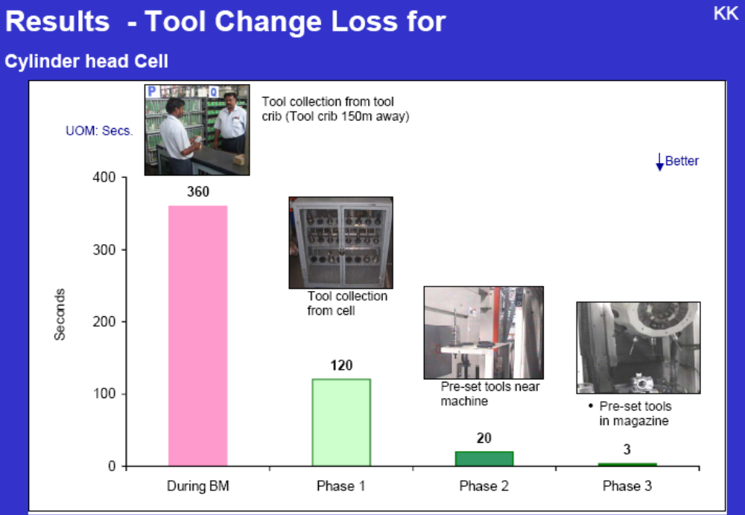
Methodology –Tool change loss reduction
KK

Slide 42
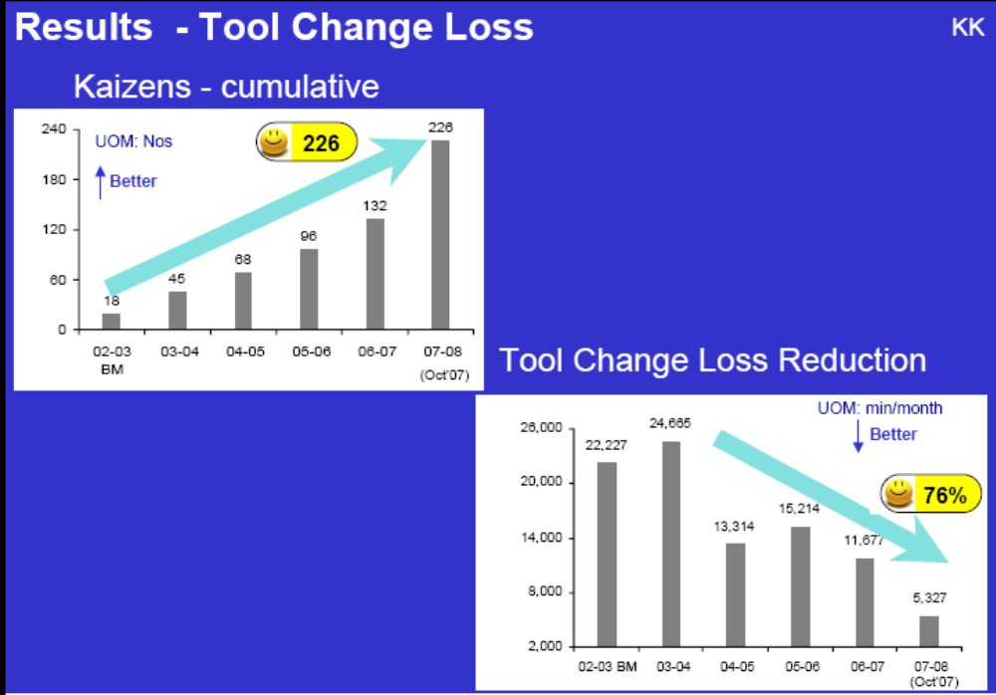
Methodology –Tool change loss reduction
KK

Slide 43
Loss No 4 – Startup loss Loss
KK
This loss does not apply to most of equipments in Engineering Industries
However, they are definitely valid for process plants such as heat-treatment furnaces, phosphating /plating plants, etc.
This loss is expressed in time.
This loss represents the time lost by the equipment from the time initially it was started till the time it is fully ready to perform its function.
This loss cannot be made zero. Our target is to reduce this loss to a practical minimum.
This loss affects Availability Rate , OEE and OPE.

Slide 44
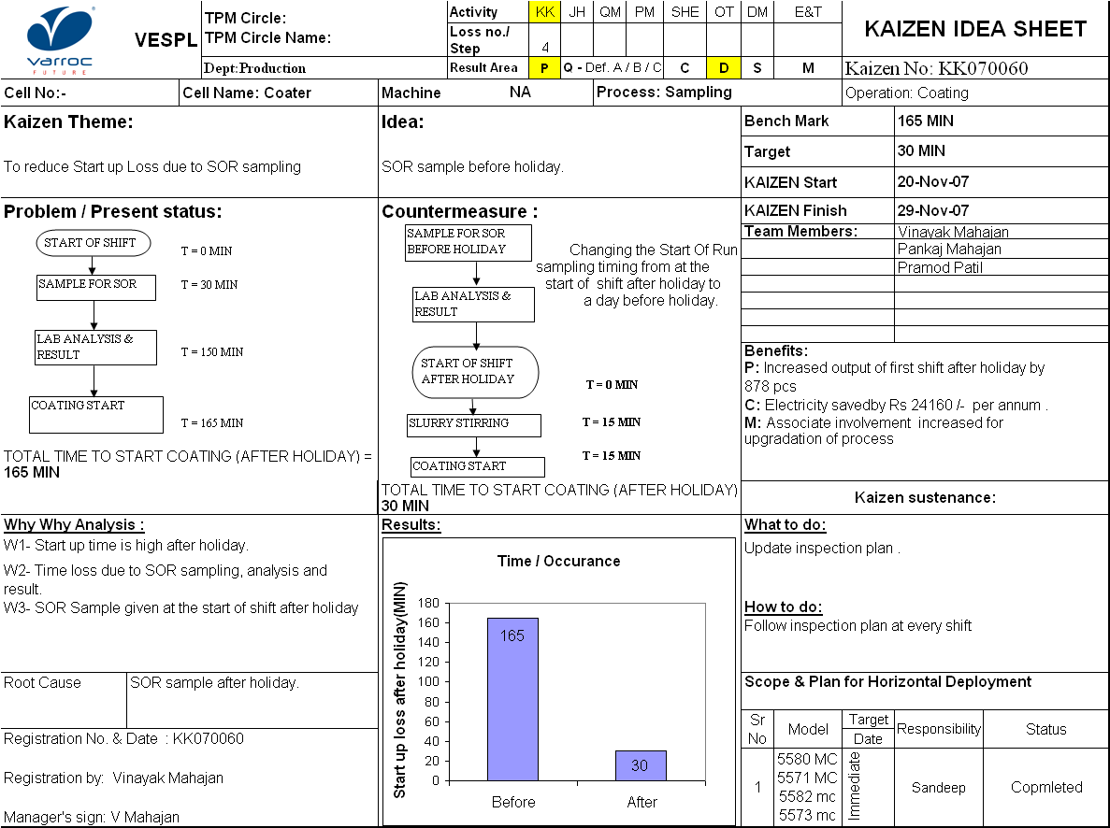
Loss No 4 – Startup loss Kaizen Example
KK

Slide 45
Loss No 5 – Minor Stoppage Loss
KK
This loss does not apply to machines not connected with auto feeding and assembly lines.
This loss is not expressed in time, since normally the stoppage is for a very short duration. It is normally expressed as number of occurrences.
This loss represents the output lost by the equipment due to minor stoppages or due to idle strokes of the equipment.
This loss affects Performance Rate, OEE and OPE.

Slide 46
“KAIZEN” PROGRAM TO IMPROVE MINOR STOPPAGE LOSS
KK
1. Understand Present Status
Survey the actual condition of phenomena.
Where they occur, how may, how frequently, with what product when, and in what condition (including condition by program).
2. Analyze Phenomena
Stratify Phenomena.
PM analysis.
List all ‘fugai that can be considered.
3. Identify, Restore and Improve Sight Defects and ‘Fugal.
Keep equipment and machines clean
Attaching and removing ‘EFU’.
Attach ‘EFU’ in place for each slight defect or ‘Fugal.
Check during ‘Jishu-Hozen’ activity.
4. Verify Results
Verify effects.
Reflect in ‘Jishu-Hozen’ criteria.
Select problems for zero minor stoppages.
5. Study Optimal Condition
Compare with design conditions.
Improve design weakness.

Slide 47
Loss No 6 – Reduced Speed Loss
KK
This loss does not apply to machines, which run at single fixed speed. However, if the machine has multi-speeds of continuously variable speed, this loss gains lot of significance.
This loss is not expressed in time.
This loss represents the output lost by the equipment due to running the equipment at speed lower than the design speed.
This loss affects performance, OEE and OPE.
After eliminating this loss, we have to challenge even the design speeds.

Slide 48
Loss No 7 – Defect & rework Loss
KK
This loss is expressed as in-process rejection loss
This loss is not expressed in time, but as quantity rejected and quarantined for sorting.
This loss represents the total quantity rejected during OQA at source and then sorted out as “OK” or “reworked” or “scrapped”.
If sampling inspection is done the rejected quantity will be more than the defects quantity.
This loss can be made zero. But it may require thorough analysis using why-why analysis and PM analysis techniques.
This loss affects Quality Rate, OEE and OPE.

Slide 49
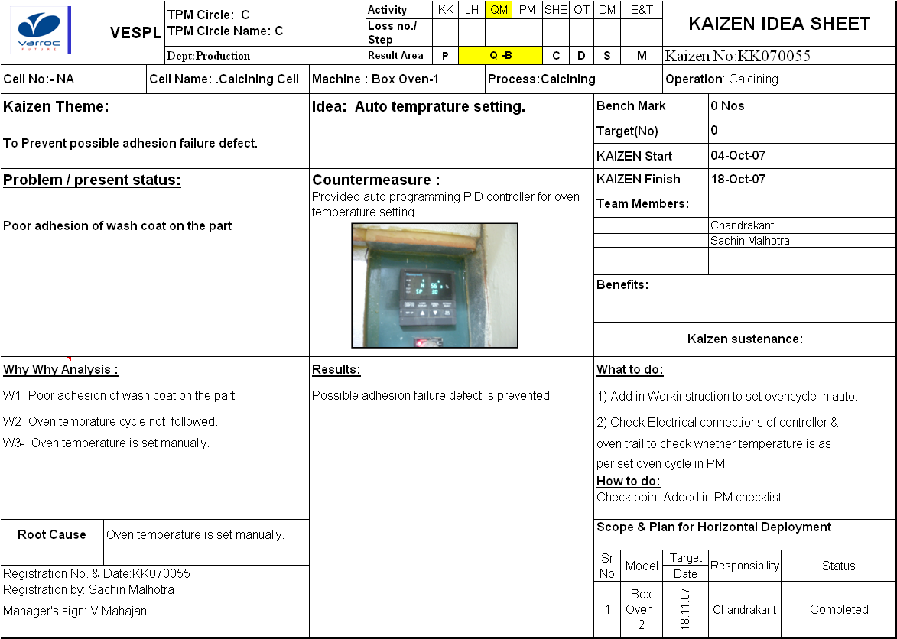
Loss No 7 – Defect & rework Loss Kaizen
KK

Slide 50
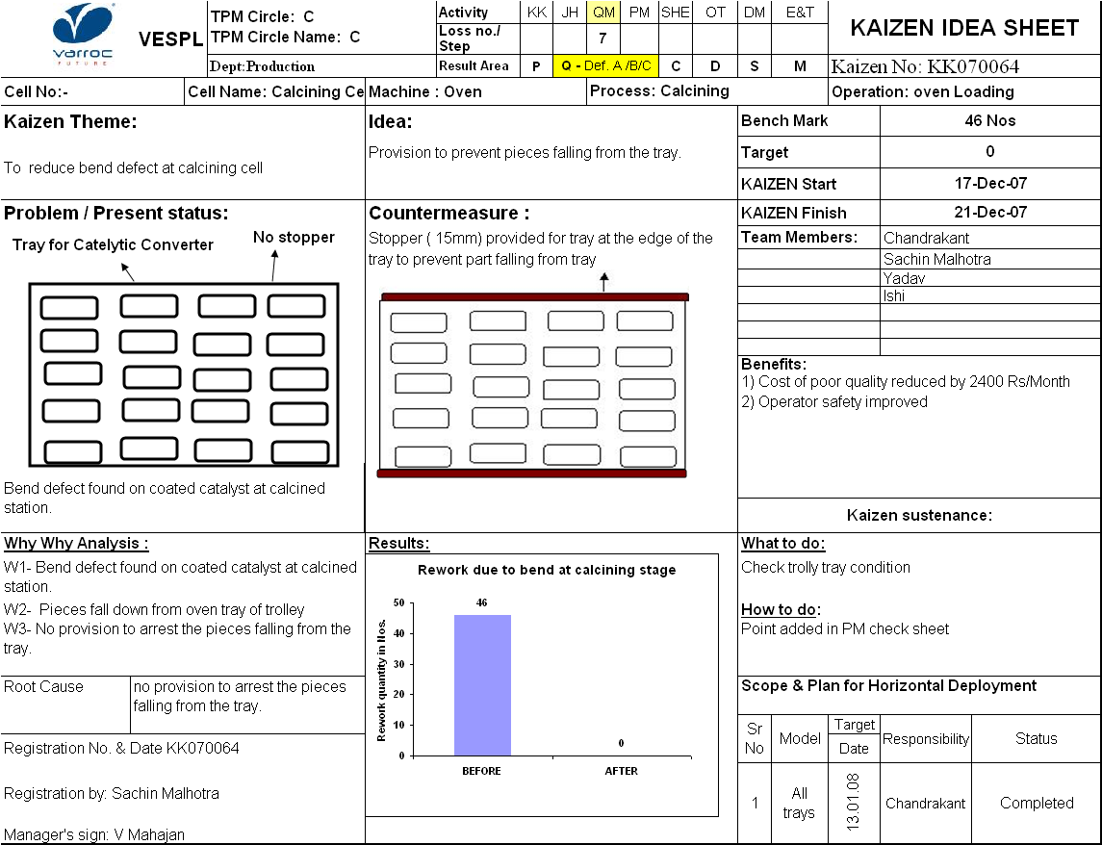
Loss No 7 – Defect & rework Loss
KK

Slide 51
Loss No 8 – Schedule downtime Loss
KK
This is an equipment-related loss, wherein the equipment is “scheduled” to be kept under downtime due to certain permitted reasons.
Typically, such reasons are, JH/PM activity time, meeting time etc.
This loss is sub-classified as follows:
8A = JH activity time
8B = PM activity time
8C = Meetings
8D = Development time
8E = Not scheduled at all
Mostly, this loss will affect only OPE. This loss is expressed in time.
However, some companies excluded 8D and 8E even for OPE calculation.

Slide 52
Loss No 9 – Management Loss
KK
This is a manpower-related loss, wherein the equipment as well as the operator is idle because of failure by management to provide the necessary inputs to the equipment.
Typically, such failures are non-availability of RM, tools, containers for collection of products, etc.
This loss is sub-classified as follows:
9A=want of tools
9B=want of instructions
9C=want of RM
9D=want of men
9E=want of gas
9T=want of container etc
Mostly, this loss will affect only OPE. This loss is expressed in time.
However, some companies excluded want of power and want of orders even for OPE calculation.

Slide 53
Loss No 9 – Management Loss
KK
Methodology
Management Loss reduction
Identification of loss machine wise, cell wise , process wise & plant level
Observe / record all activities
Preparation of activity / time sheet
Give feedback to,
OTPM Pillar
Loss reduction by proper scheduling
Result
PM Pillar
Analysis of losses
QM Pillar

Slide 54
Loss 10 to Loss 13
KK
These are other man-power related losses. These are not mostly applicable to some industries.
Loss No. 10: Operating Motion Loss
It is output loss due to operator skill and efficiency.
This affects performance rate, OEE and OPE of the equipment
Loss No. 11: Line Organisation Loss
It is the output lost due to idling of line or multi-machine operations.
This affects performance rate, OEE and OPE of the euipment
Loss No. 12: Logistics loss
It is the time lost due to operator stopping the machine to do other works.
This affects OPE, as this is strictly a management loss.
Loss no. 13: Measurement and Adjustment loss
It is the output lost due to adjustments to correct quality problems.
The difference between loss nos. 5 and 13 is that, in 5, the machine stops and we do correction, but, in 13, we stop the machine to do correction.
This affects performance rate, OEE and OPE of the equipment.

Slide 55
Loss 10 Operating Motion Loss
KK
Methodology
Identification of loss stage wise, cell wise , process wise & plant level
Observe / record all activities
Preparation of activity / time sheet
Motion loss reduction by,
Analysis of 7 major losses of human motions
1.Waiting time losses
2. Walking time losses
3. Transportation time losses
4. Searching time losses
5. Judgment time losses
6. Set up and adjustment losses
7. Defect Losses
Result
Loss reduction by doing kaizens

Slide 56
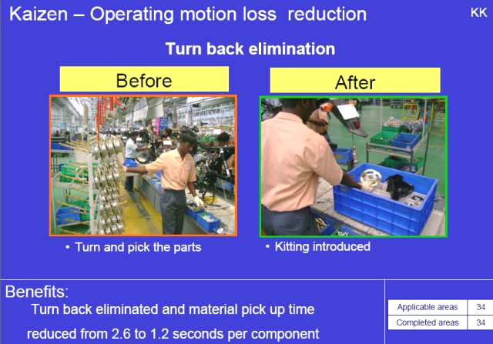
Loss 10 Operating Motion Loss
KK

Slide 57
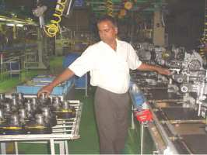
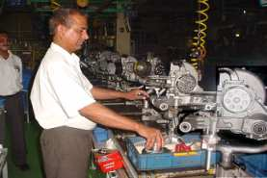
Loss 10 Operating Motion Loss
KK
Motion loss (Movement Loss - Twisting) is reduced by providing material kit in front of operator. Also transportation of cylinder block from trolley to conveyor slat is eliminated
After : Operator is collecting block and piston from kit bin , which is kept in front of him.
Transportation
Before : For collecting block & piston operator twisted by 120⁰

Slide 58
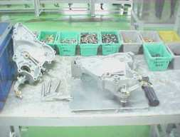
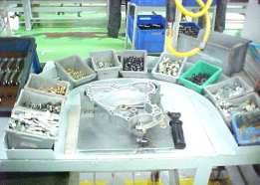
Loss 10 Operating Motion Loss
KK
Searching time loss is reduced by sequential
arrangement of parts
Sequential arrangement of parts
Searching time loss due to random arrangement of parts

Slide 59
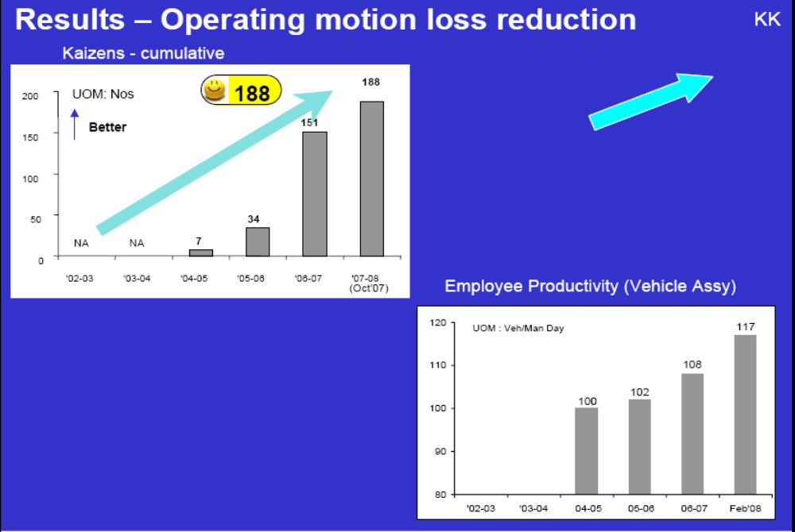
Result of Operating motion loss
KK

Slide 60
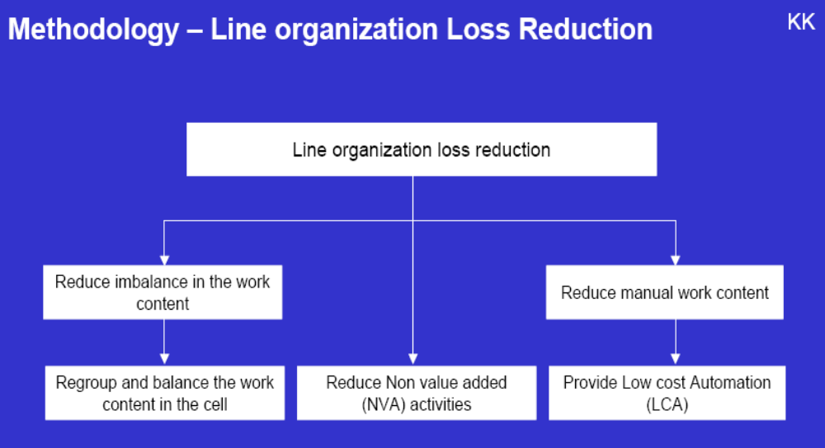
Loss 11 Line organisation Loss
KK

Slide 61
Loss 14 to Loss 16 (Cost loss)
KK
These are energy related and material related losses. These are mostly related to the yield or efficient usage of material and energy resources. Some of the losses are difficult to be measured.
Loss No. 14: Energy loss
It is the money lost due to inefficient use of energy
This may not affect the equipment OEE/OPE, but, affects cost.
Loss No. 15: Die, jig and tool loss
It is the money lost due to inefficient use of indirect materials.
This may not affect the equipment OEE/OPE, but, affects cost.
The various indirect materials, which are covered under this loss, are tools, spares, packing materials, oils, lubricants, consumables, etc.
Loss no. 16: Yield loss
It is the money lost due to inefficient use of direct materials, viz. RM.
This may not affect the equipment OEE/OPE, but, affects, cost.
Yield loss is expressed as percentage yield.

Slide 62
Cost Loss Tree
KK
COST TREE
Manufacturing Cost
Material Cost
Variable conversion cost
Fixed Cost
Buying
Yield
Tools
Consumable
Energy
Labour
Depreciation
Paint and
Sheet
KK
KK
KK
KK
KK

Slide 63
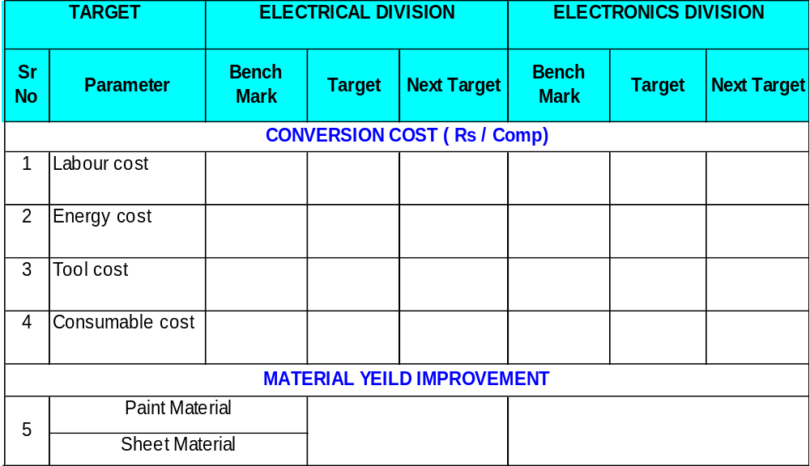
Cost loss
KK

Slide 64
Cost loss
KK
Labour Cost Reduction Approach
Making stage wise ( Machine wise ) Matrix for work content
Identification of fastest & Slowest process
Stratification of reasons for slowest due to
a) Manual work content
b) Machine cycle time
Result
Loss reduced by speed up manual activity
Loss reduced by series to parallel activity
Labour Cost Reduction Kaizen idea
Method Change
NVA Deletion
Reduce movement
Automation
Reduce material handling

Slide 65
Cost loss
KK
Energy Cost reduction Approach
Making stage wise (machine wise ) matrix for content
Identification of Energy loss factors
Energy loss due to a)Leakages b) Under utilization
Energy cost reduction by,
Result
Modify equipment
Optimum utilization
Unconventional Source
Energy Cost reduction Kaizen Idea
Modify Equipment
Auto Timer
Optimum utilization

Slide 66
Cost Loss
KK
Consumable Cost reduction Approach
Identification of consumables consumption machine wise, cell wise , process wise & plant level
Observe / record cost details
Preparation of cost loss matrix
Consumables Cost reduction by,
Result
Arrest wastage
Low cost alternative
Consumable Cost reduction Kaizen Idea
Elimination
Method Change
Alternate Material

Slide 67
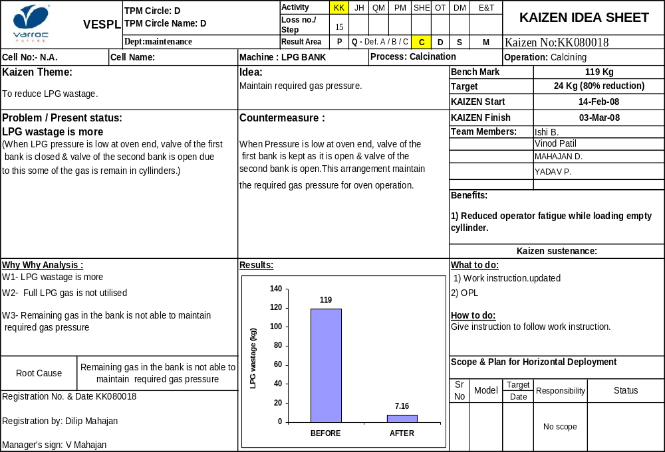
Consumable Cost Kaizen
KK

Slide 68
Cost Loss
KK
Material yield ( Improvement ).Yield Improvement
Data collection of component wise gross weight , scrap weight & net weight
Cost loss for sheet Metal
Yield loss reduction by reduction in scrap weight
Kaizen / countermeasure
Yield loss reduction by develop indigenous source
Yield loss reduction by material thickness reduction
Result
Material Yield Improvement Kaizen Idea
Paint Yield Improvement
Sheet Yield Improvement
Reduce air painting
Reduce wastage in cleaning
Eliminate touchup
Reduce thickness
Reduce defects
Improve booth conditions
Use alternate equipment
Improvement in Paint & thinner
Scrap weight reduction
Die design change
Optimum blank size
Alternate material

Slide 69
Thanks

